Slide 1
Spring Boot 2.0
Michał Jereczek

Slide 2
Plan prezentacji
Czym jest Spring Boot?
Nowości w 2.0
Kotlin
Elasticsearch
Reactive programming
Niespodzianka
Podsumowanie i pytania

Slide 3
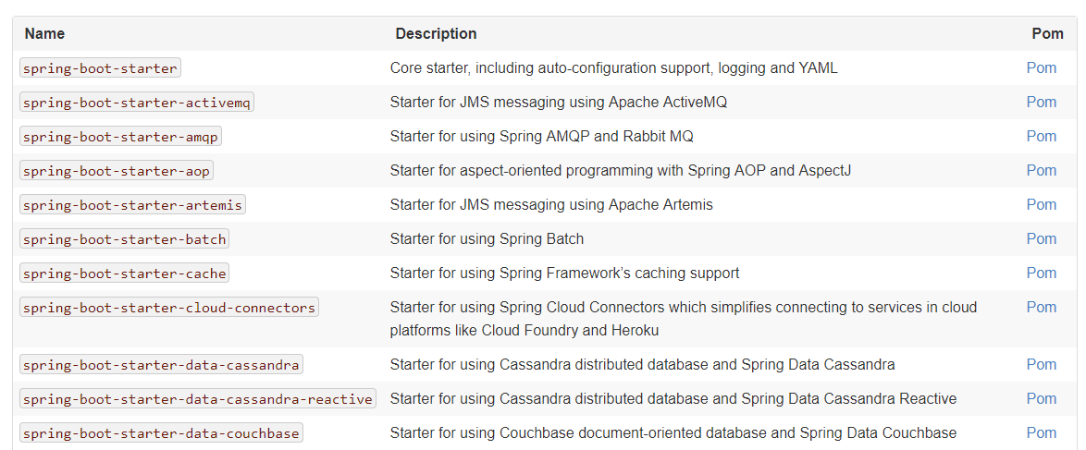
1. Czym jest Spring Boot?
Convention over configuration
Źródło: https://docs.spring.io/spring-boot/docs/current/reference/htmlsingle/#using-boot-starter

Slide 4
2. Nowości w 2.0

Slide 5
2.1 Kotlin
Null safety
Funkcje rozszerzeń (RestTemplate, TestRestTemplate, RestOperations, runApplication)
Wtyczki maven/gradle
Webflux DSL
Html Template DSL
import org.springframework.boot.autoconfigure.SpringBootApplication import org.springframework.boot.runApplication @SpringBootApplication class FooApplication fun main(args: Array<String>) { runApplication<FooApplication>(*args) }

Slide 6
2.2 Elasticsearch
# Wartości domyślne. Elasticsearch w wersji 5.4 spring.data.elasticsearch.cluster-name=elasticsearch spring.data.elasticsearch.cluster-nodes=localhost:9300
application.properties -> konfiguracja połączenia z ES
@Document(indexName = "category", type = "category", createIndex = true) data class Category private constructor( @Field val categoryName: String? = null, @Id @JsonIgnore val id: String? = categoryName, @Field val categorySchema: Any? = null )
Klasa mapujące pojedynczy typ w ES
@RepositoryRestResource(collectionResourceRel = "dictionary_entry", path = "dictionary_entry") interface DictionaryEntryRepository : ElasticsearchRepository<DictionaryEntry, String>
Interfejs, który automatycznie generuje REST API

Slide 7
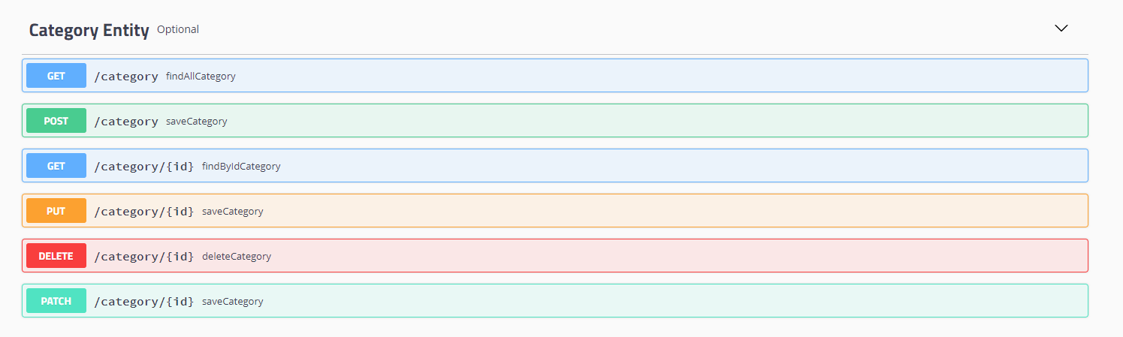
2.2 Elasticsearch
* Drobne oszustwo

Slide 8
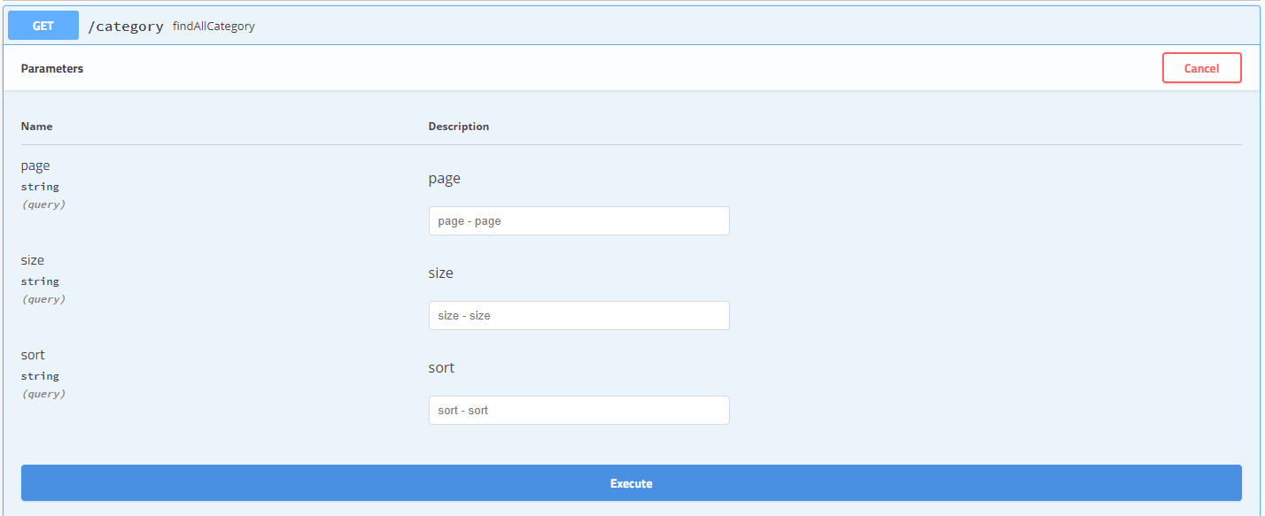
2.2 Elasticsearch
* Drobne oszustwo

Slide 9
2.3 Reactive programming
Spring WebFlux & WebFlux.fn
Reactive Spring Data
Reactive Spring Security
Embedded Netty Server
Polecam: https://docs.spring.io/spring/docs/current/spring-framework-reference/web-reactive.html#webflux-framework-choice

Slide 10
2.4 Niespodzianka
Źródło: https://github.com/spring-projects/spring-boot/wiki/Spring-Boot-2.0-Release-Notes

Slide 11
3. Podsumowanie i pytania
Źródła:
https://spring.io/blog/2018/03/01/spring-boot-2-0-goes-ga
https://docs.spring.io/spring/docs/current/spring-framework-reference/web-reactive.html
https://docs.spring.io/spring-boot/docs/2.0.x-SNAPSHOT/reference/htmlsingle/#boot-features-kotlin
https://docs.spring.io/spring/docs/5.0.5.BUILD-SNAPSHOT/spring-framework-reference/languages.html#kotlin
https://docs.spring.io/spring-boot/docs/current/reference/htmlsingle/#using-boot-starter
https://github.com/spring-projects/spring-boot/wiki/Spring-Boot-2.0-Release-Notes

